Slide 1
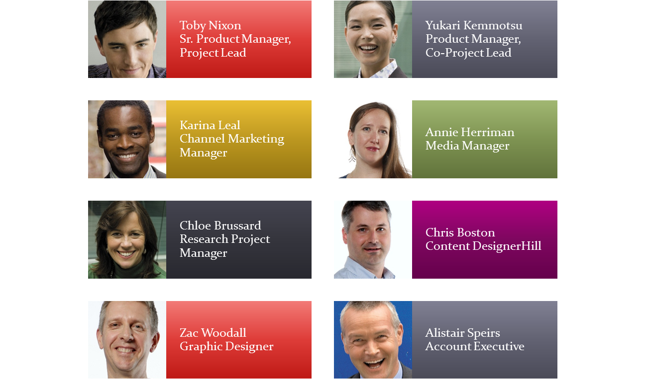
Legal Compliance Policies
Status update and planning overview

Slide 2
Contoso Story
½ the Price of our competitors
TRIPLE the value!
Equals customers who come back for more!

Slide 3
Billboard Campaigns for Denver
Spring season
Show we have done research
Incorporate video when possible

Slide 4
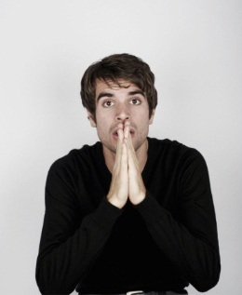

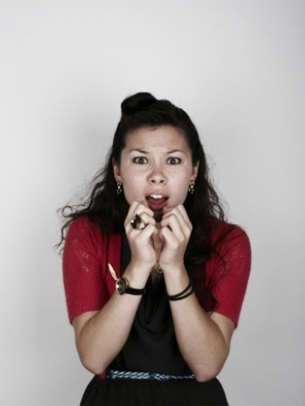

Emotional Connection
Emotional connection with regional customers is key to good expansion
The right connection inspires brand loyalty
It’s time to break new ground with our strategy
Let’s get ready for the Denver Holiday season!

Slide 5
Regional Design considerations
What Creates a Connection?

Slide 6
Denver Current trends
Clean/minimalist
Creative use of type
Fresh use of color

